Slide 1

Recruiter – Recruitment Management System based on Django
Saaras Gaikwad – 22207003
Meet Jamsutkar – 22207004
Umesh Nehete – 22207006
Vedant Mayekar - 22207007
Project Guide
Prof. Poonam Pangarkar

Slide 2
Contents
Introduction
Objectives
Scope
Features / Functionality
Project Outcomes
Technology Stack
Block Diagram

Slide 3
1. Introduction
Recruiter is a tool for managing the hiring process.
It is based on the Django framework.
Problem Identified :
Less efficient recruitment process.
Cost can be a problem, with some RMS being expensive to implement and maintain.
Solution Proposed:
The solution proposed is a centralized interface for organizations and end users for managing talent related needs.

Slide 4
2. Objectives
To help organizations manage their recruitment processes more efficiently.
To improving the quality of hires.
Improving candidate experience

Slide 5
3. Scope
Applied on various job posting platforms, including job boards, social media, and any company's website.
Useful for large organizations , recruitment agencies.
Influential in data-driven decision making

Slide 6
4. Feature /Functionality
Customizability:
Users of any kind can edit all the basic details of their profile.
Account Management:
Institutions can add multiple recruiters on its behalf.
Three different kinds of users can register and login. (Admin , Recruiter , Applicant)
Applications
Applicants can apply for job openings
Recruiters can publish Job openings.
Recruiters can shortlist applicants who apply for job openings.
Admins can view the list of people who have applied for the job posting posted by the recruiters..

Slide 7
5. Outcome of Project
Institutions/Organizations Can create a multi-user account, assign an admin. Admin has the ability to edit all the important company details. Receives the list of individuals who have applied for the job posting posted by the Recruiters.
Recruiters can create a job opening, shortlist applications, and chat with the shortlisted applicants. recruiters finalize and provide the shortlisted applicants list to the admin.
Applicants can create an account, login into the website and view different job postings, applicants can apply for Job postings of their choice and wait for getting shortlisted. Applicants have the ability to edit all the necessary applicant details.

Slide 8
6. Technology Stack
Front-End
HTML 5
CSS 3
Python 3.10
FontAwesome 4.5
Bootstrap 5
Back-End
Django 4.1.5
MySQL 8
Pillow 9.8.4
​
Tools
Figma
VS Code

Slide 9
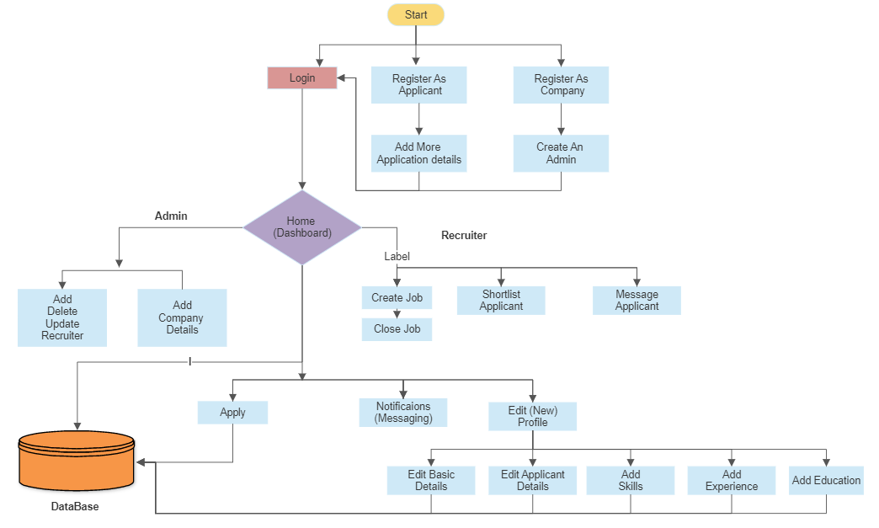
7. Block Diagram
Applicant

Slide 10
Thank You...!!

